Slide 1
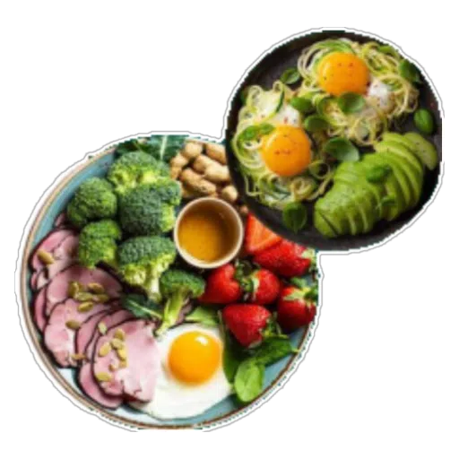
Nourish Note
Team Name: Byte & Bites
Sontineni Bhavya Sri Sai-002893685
Madhuri Tumula-​002892521

Slide 2
Introduction
Nourish Note is a Flutter-based mobile application designed to simplify meal planning and grocery management for users. It enables users to:
Plan meals for the week.
Browse through recipe categories.
Maintain a grocery list.
View personalized meal plans based on their preferences.
The app also includes user profile management, and is designed to enhance the overall experience of organizing food-related activities in a structured and accessible way

Slide 3
Target Audience:
Home Cooks: From beginners to experienced chefs
Health-Conscious Users: Dietary filters for vegetarian, vegan, keto, etc.
Busy Individuals: Meal planning and grocery list for efficient prep and shopping
Technical stack :
Frontend : Flutter for cross-platform support
Backend : SQLite for local storage of user data and recipes

Slide 4
Problem Statement
People struggle with meal planning, especially with dietary restrictions, leading to time wastage and nutritional imbalance.
Need for centralized solutions for recipes, meal planning, and grocery organization.
Often people rely on convenience foods, which compromises overall nutritional quality.
Hence there is a significant demand for integrated solutions that streamline meal planning and promote healthier eating habits.

Slide 5
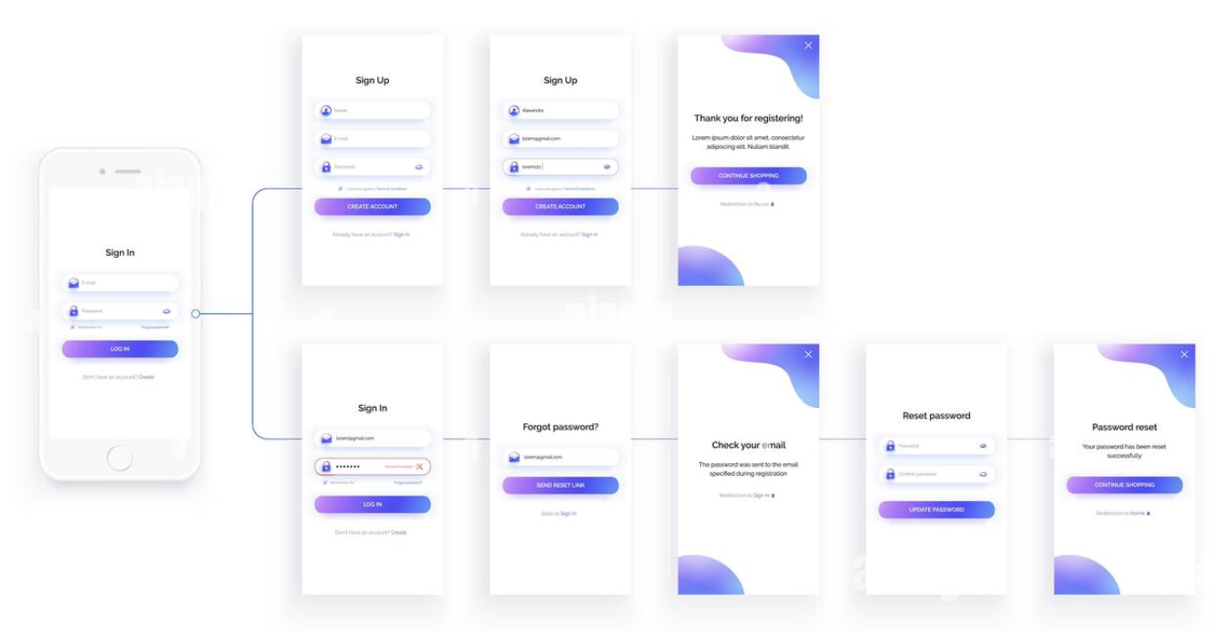
Application Overview
Login Authentication: Enables secure user access through unique credentials.
Recipe Management: Access a diverse library of dietary-specific recipes.
Personalized Meal Plans: Create tailored meal plans based on individual needs.
Grocery List: creating grocery lists for selected recipes.
Favorites and Filters: Save favorite recipes and use filters for dietary preferences.

Slide 6
Testing
Testing Process:
Manual testing to ensure functionality.
Plan :
1.Functional tests on recipe search, meal planning, and grocery list generation.
2.Usability testing for smooth navigation and accessibility.
3.Simulated recipes and grocery list data for various user profiles and dietary needs.

Slide 7
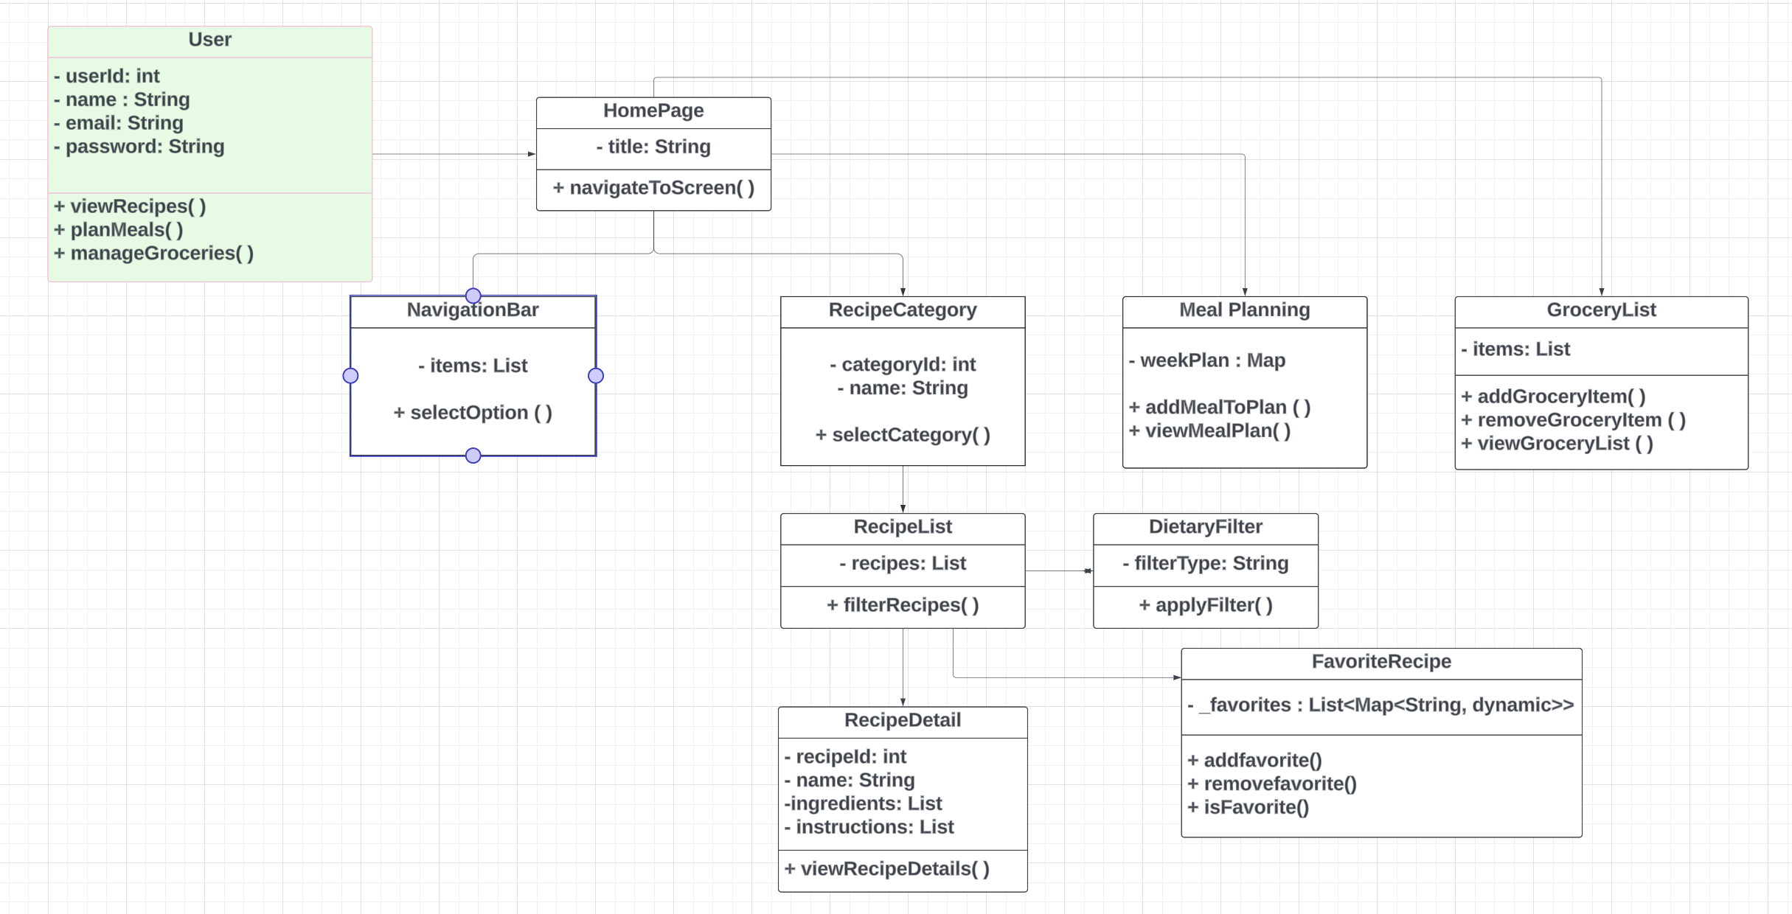
USE CASE DIAGRAM:

Slide 8
DETAILED EXPLANATION

Slide 9
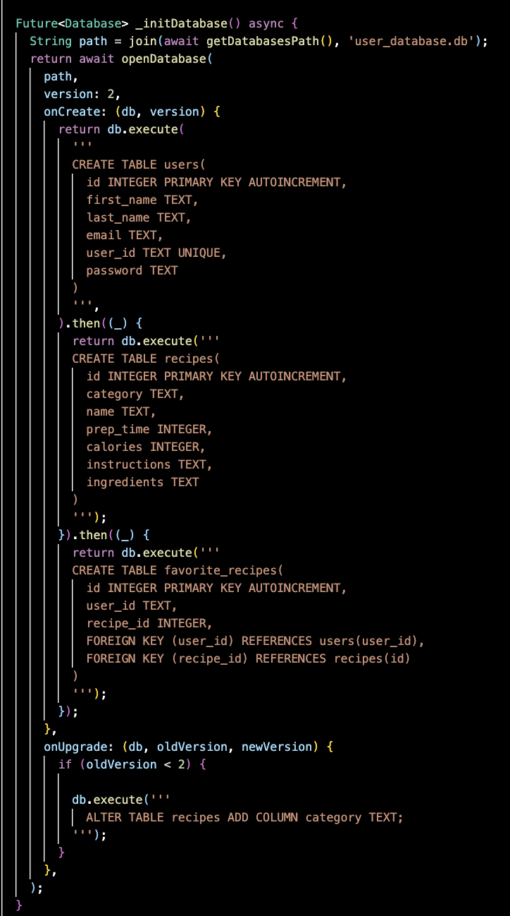
Database structure :
There are three tables in database users, recipes, favorite_recipes.
Various methods were used for the features functionality like insertUser, getUser, getUserProfile, updateProfile, updatePassword, inserRecipe, getRecipes, addFavorite, removeFavorite.

Slide 10
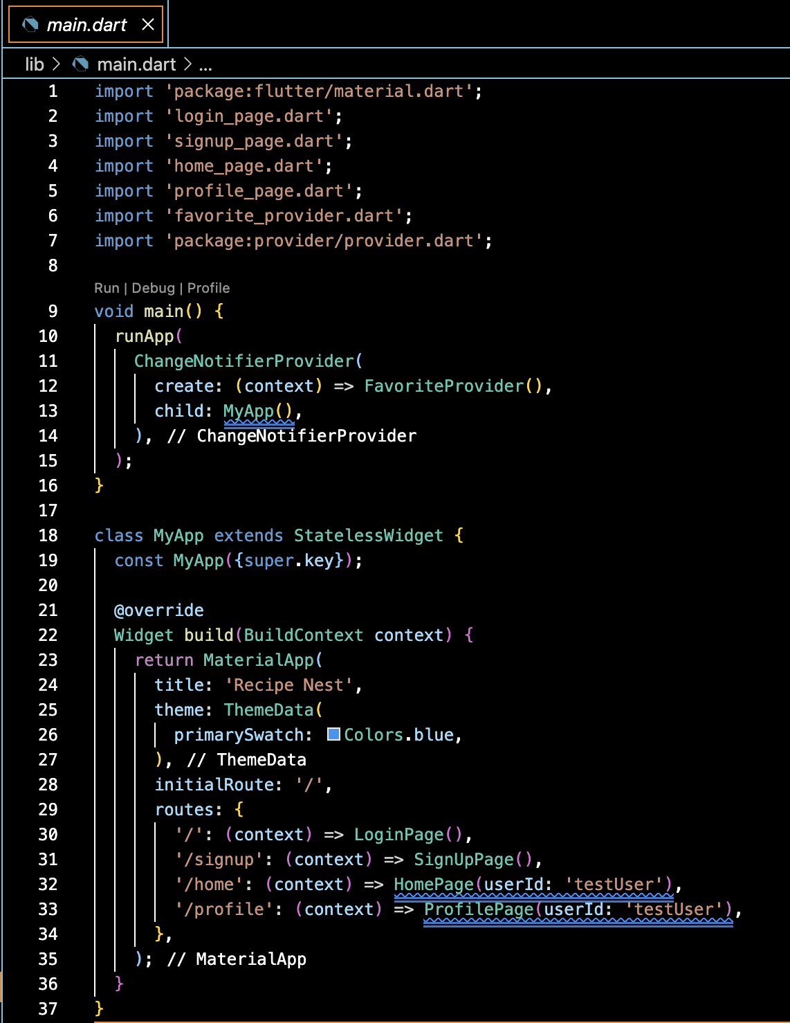
main.dart file :
It contains details about the flow of the application navigation.

Slide 11
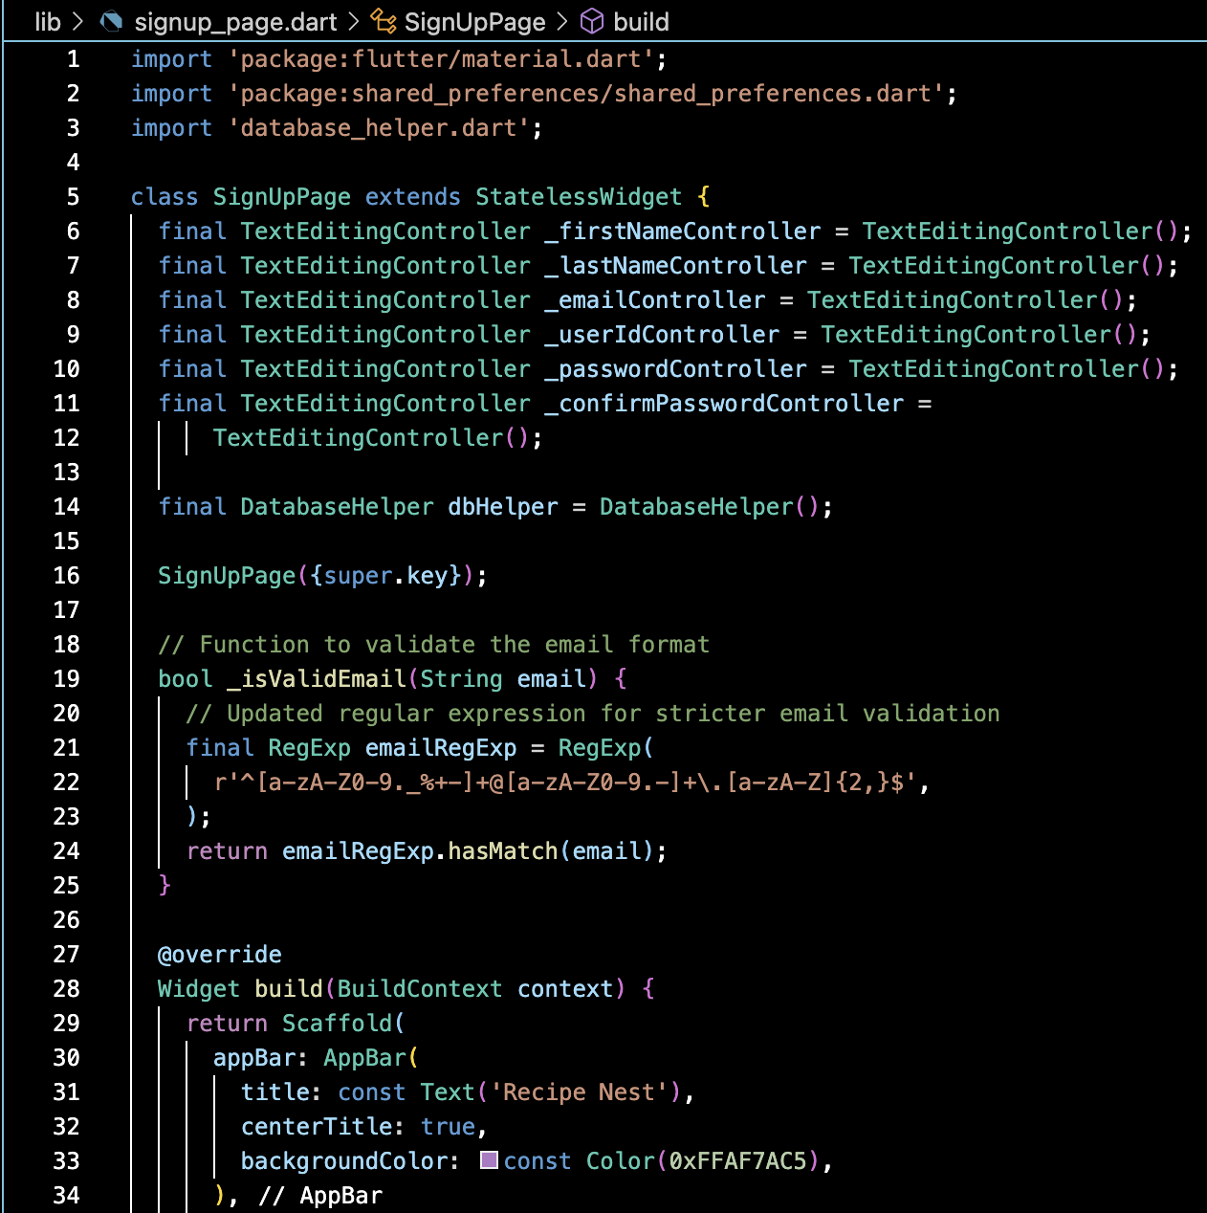
Signup Page :
Users first need to register inorder to access the application.
All fields are necessary inorder to register.
Required constraints were included for proper information.

Slide 12
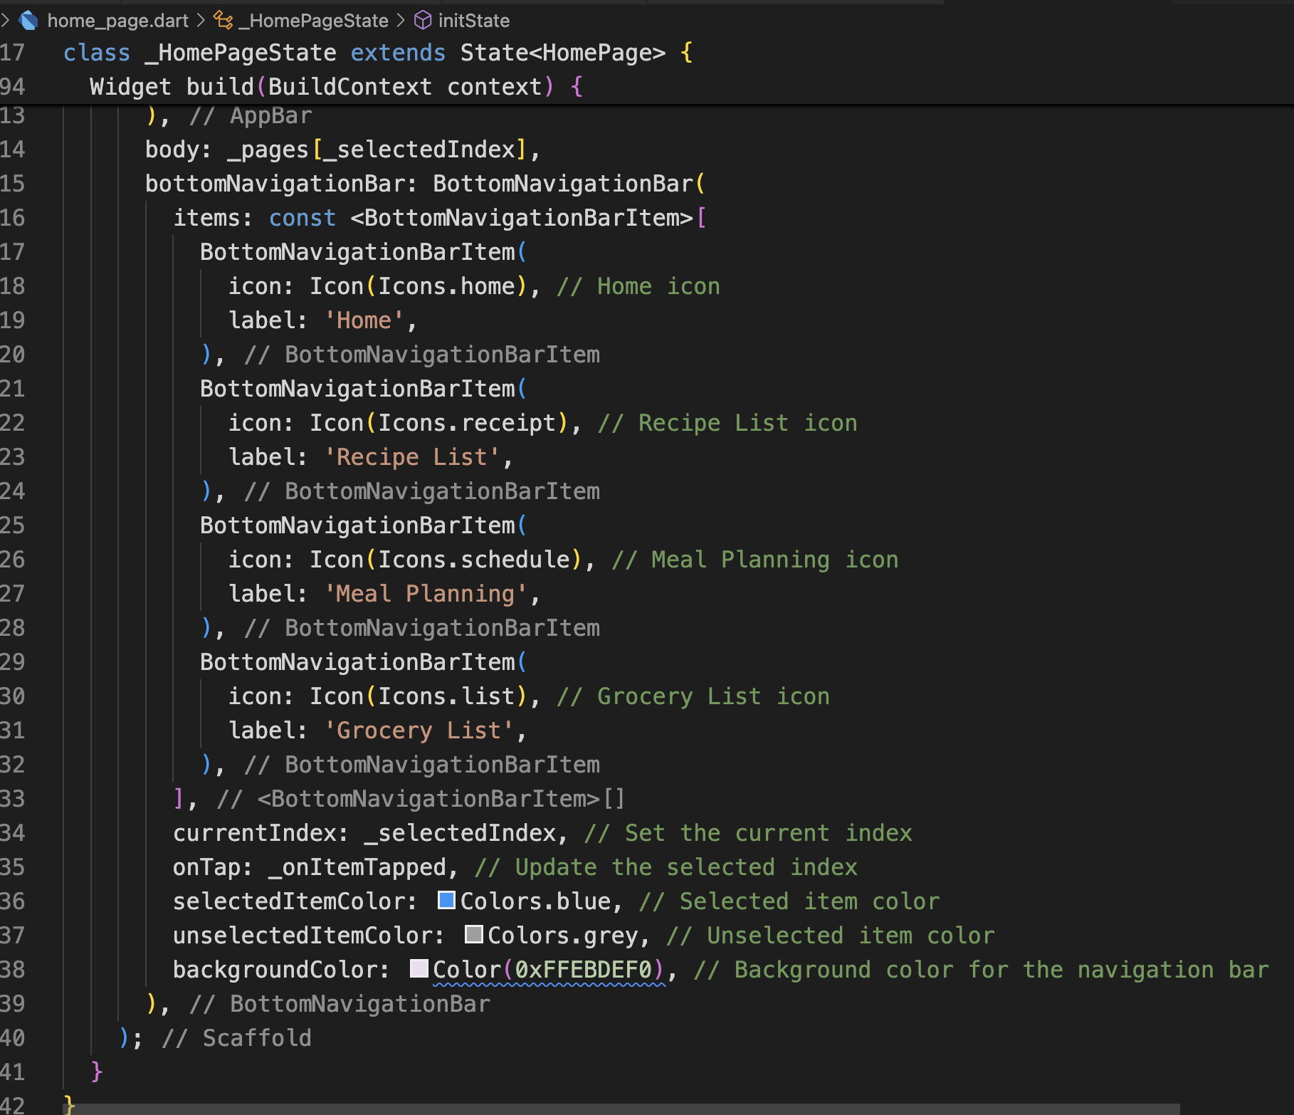
HOME PAGE
The Home Page acts as the main dashboard with BottomNavigationBar that lets users navigate to different sections of the app. Each tab corresponds to a different screen, such as "Today's Meal Plan," "Recipe List," "Meal Planning," and "Grocery List.”
Key Components:
AppBar: Displays the title and profile icon.
BottomNavigationBar: Provides navigation between different sections of the app.
Navigation to Profile: Clicking the profile icon takes the user to their Profile Page

Slide 13
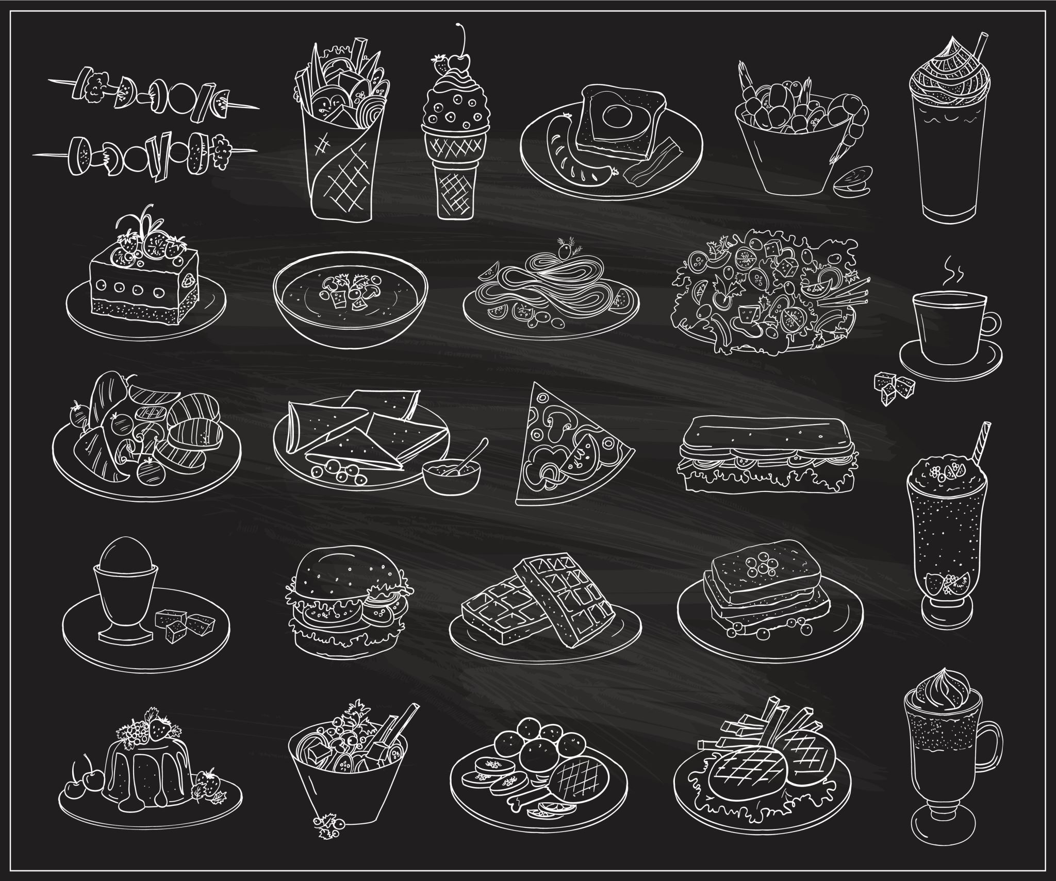
Recipe List Screen
The screen allows user to view various recipes available in the application along with their calories count and preparation time.
- Initially a list various food categories are displayed to be selected.
- Inputs include : userId and category.

Slide 14
Favorite Recipe Screen
The screen allows user to add various recipes available in the application to be added to favorites.
- These recipes can be navigataed to their detailed recipe page seamlessly.
- Inputs include : userId and category.

Slide 15
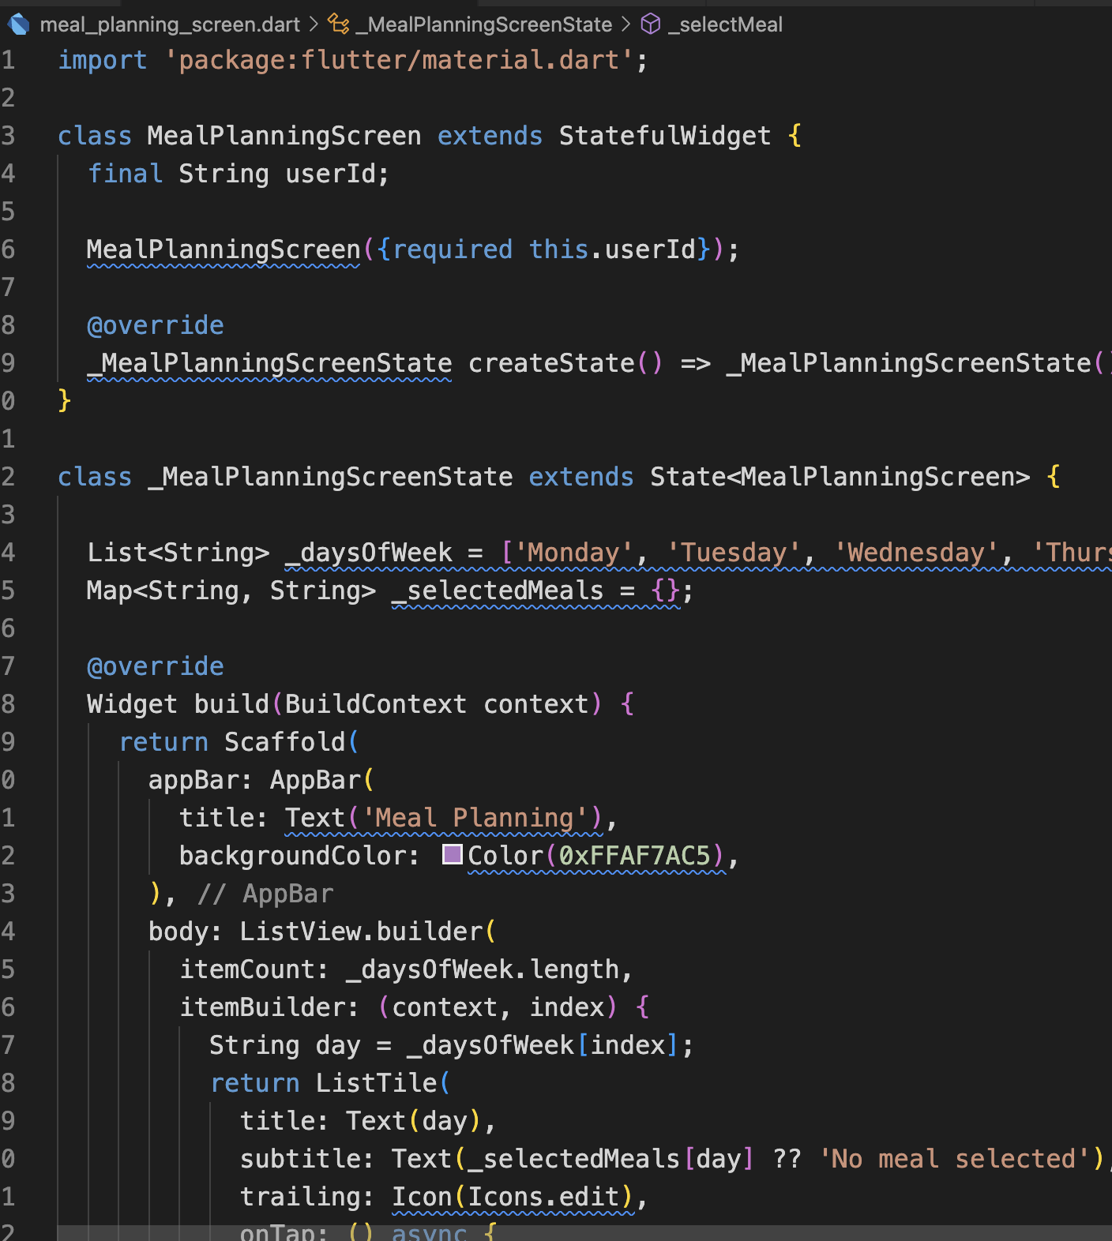
MEAL PLANNING SCREEN
The Meal Planning Screen allows users to plan their meals for each day of the week. Users can select a meal for a specific day, and the selection is stored in a list.
Key Features:
A list of days of the week.
Users can tap on a day to choose a meal from a predefined set of meals.
The selected meal is displayed under each day.

Slide 16
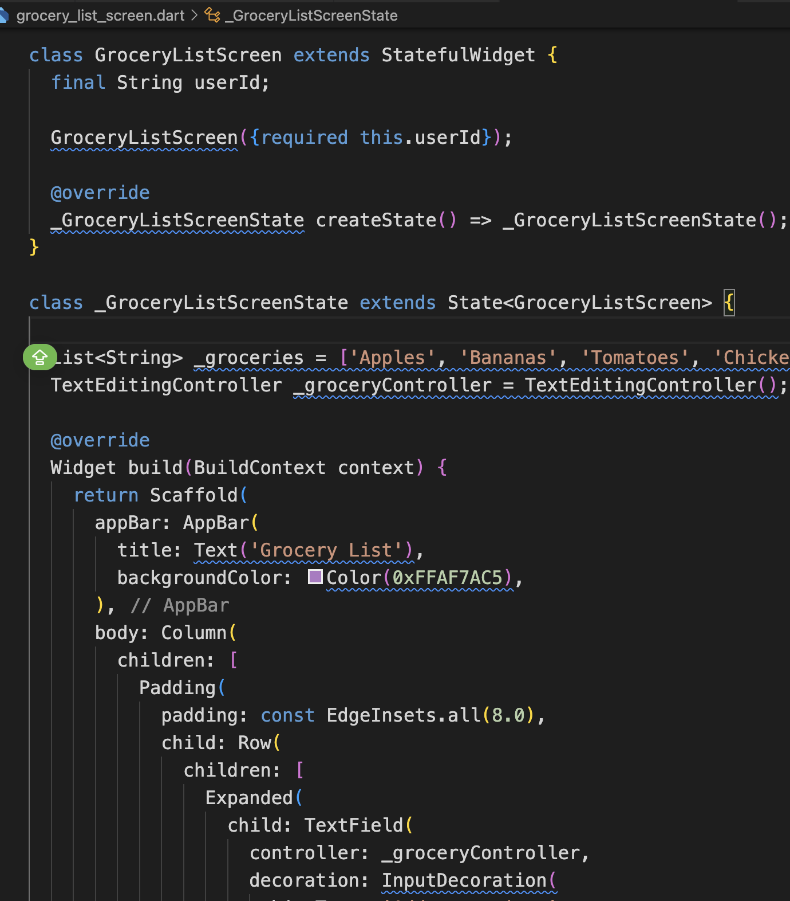
GROCERY LIST SCREEN
The Grocery List Screen allows users to maintain a list of grocery items. Users can add, view, and delete items from their grocery list.
Key Features:
Users can input a new grocery item into a TextField and add it to the list by pressing a button.
Each grocery item is displayed as a ListTile with a delete button that allows users to remove the item.

Slide 17
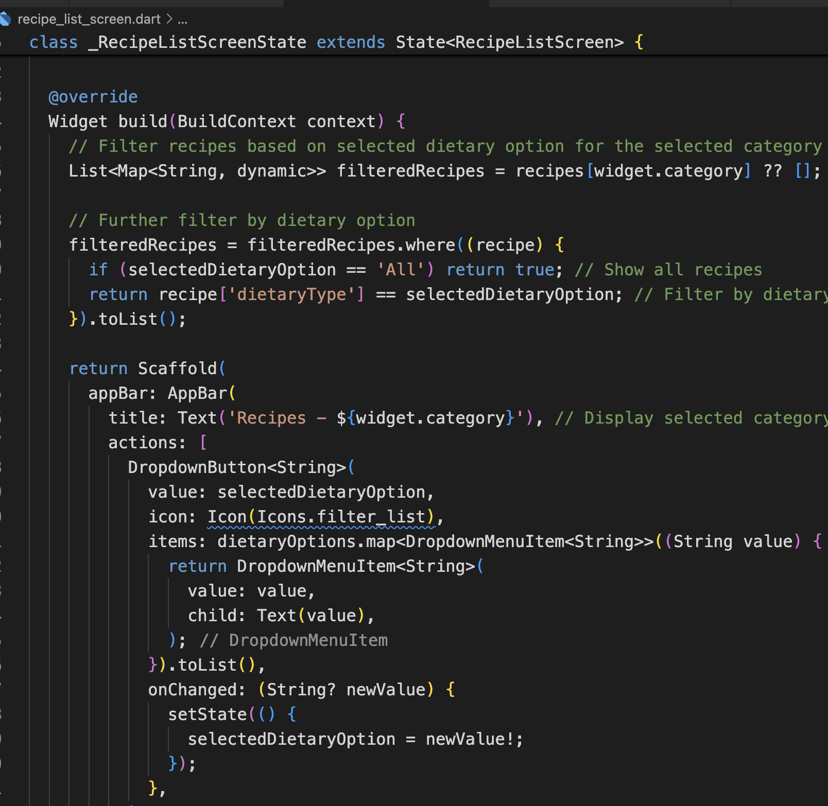
Adding DIETARY FILTER
The DropdownButton<String> widget displays a dropdown with the various dietary options.
The items parameter creates the dropdown list by mapping the available dietary options ('All', 'Vegetarian', 'Non-Vegetarian', etc.).
The onChanged function updates the selected dietary option when the user picks a new option, triggering the setState() to rebuild the widget with the filtered data.The DropdownButton<String> widget displays a dropdown with the various dietary options.
The items parameter creates the dropdown list by mapping the available dietary options ('All', 'Vegetarian', 'Non-Vegetarian', etc.).
The onChanged function updates the selected dietary option when the user picks a new option, triggering the setState() to rebuild the widget with the filtered data.

Slide 18
CONCLUSION
Nourish Note is a practical and user-friendly app aimed at simplifying meal planning and grocery management.
Built using Flutter, the app provides a seamless cross-platform experience for users, with a clean and intuitive interface
This project showcases the power of Flutter in creating scalable, maintainable, and efficient mobile applications with great potential for future expansion.

